Slide 1
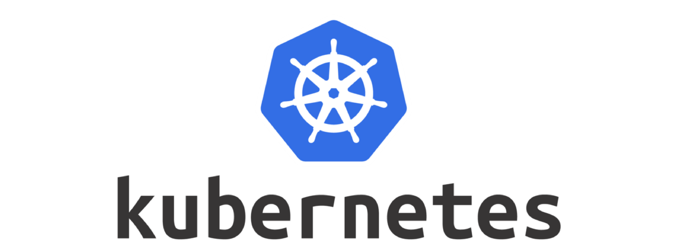
Basics of Kubernetes Architecture

Slide 2
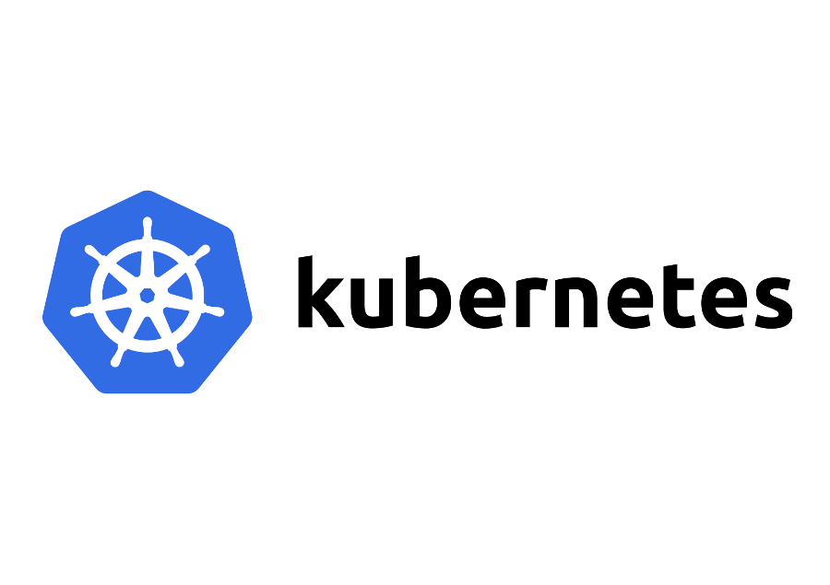

Pop Quiz: Find the relation between these

Slide 3
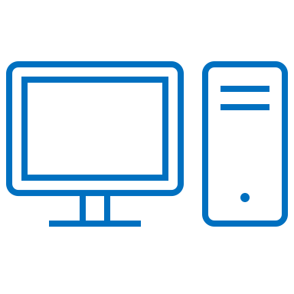
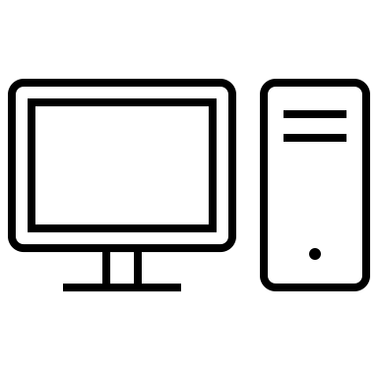
Kubernetes Cluster
Master
Node
Node
Node
Master
Control Plane

Slide 4
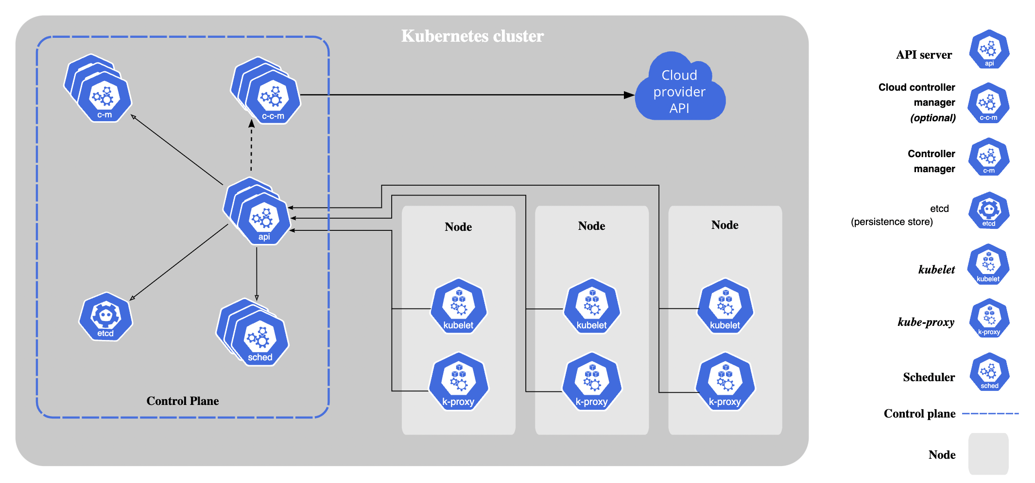
Kubernetes Components

Slide 5
Control Plane Components
API Server
Acts as the “front-end” for Kubernetes
The main implementation of a Kubernetes API server is kube-apiserver.
ETCD Key Store
Distributed reliable key-value store used to store all data used to manage the cluster.
Can be deployed as pods on control plane nodes or as an external cluster.
Also responsible for implementing locks within the cluster to ensure there are no conflicts between the Masters.

Slide 6
Control Plane Components
Controller Manager (kube-controller-manager)
Brain behind orchestration. Responsible for noticing and responding when nodes, containers or endpoints goes down. Brings up new containers in such cases.
Logically, each controller is a separate process, but to reduce complexity, they are all compiled into a single binary and run in a single process.
Types
Node controller
Job controller
EndpointSlice controller
ServiceAccount controller

Slide 7
Control Plane Components
Scheduler (kube-scheduler)
Watches for newly created pods with no assigned node and selects a node for them to run on.
Resource Requirements, Policy Constraints, Data locality etc.

Slide 8
Node Components
kubelet
An agent that runs on each node in the cluster
Responsible for making sure that the containers are running on the nodes as expected.
kube-proxy
network proxy that runs on each node in the cluster.
Takes care of networking within Kubernetes.
Container Runtime
Responsible for running containers.
kubectl get nodes -o wide
Containerd
CRI-O
Docker Engine
Mirantis Container Runtime

Slide 9
Kubernetes APIs
API Groups
/metrics
/healthz
/api
/apis
/version
/logs

Slide 10
Kubernetes APIs
Core Group
/api
/apis
/v1
namespaces
pods
services

Slide 11
Kubernetes APIs
Core Group
/api
/apis
/apps
/extensions
/networking.k8s.io
/storage.k8s.io
/authentication.k8s.io
/certificates.k8s.io
/v1
/deployments
/replicasets
.. and many more
/statefulsets

Slide 12
Kubernetes APIs : Connecting using kubectl
Option 1: Point to the TLS certificate of the API Server
curl --cacert <Certificate Path> <API URL>
Option 2: Use kubectl Proxy
kubectl proxy --port 8080
curl http://localhost:8080/

Slide 13
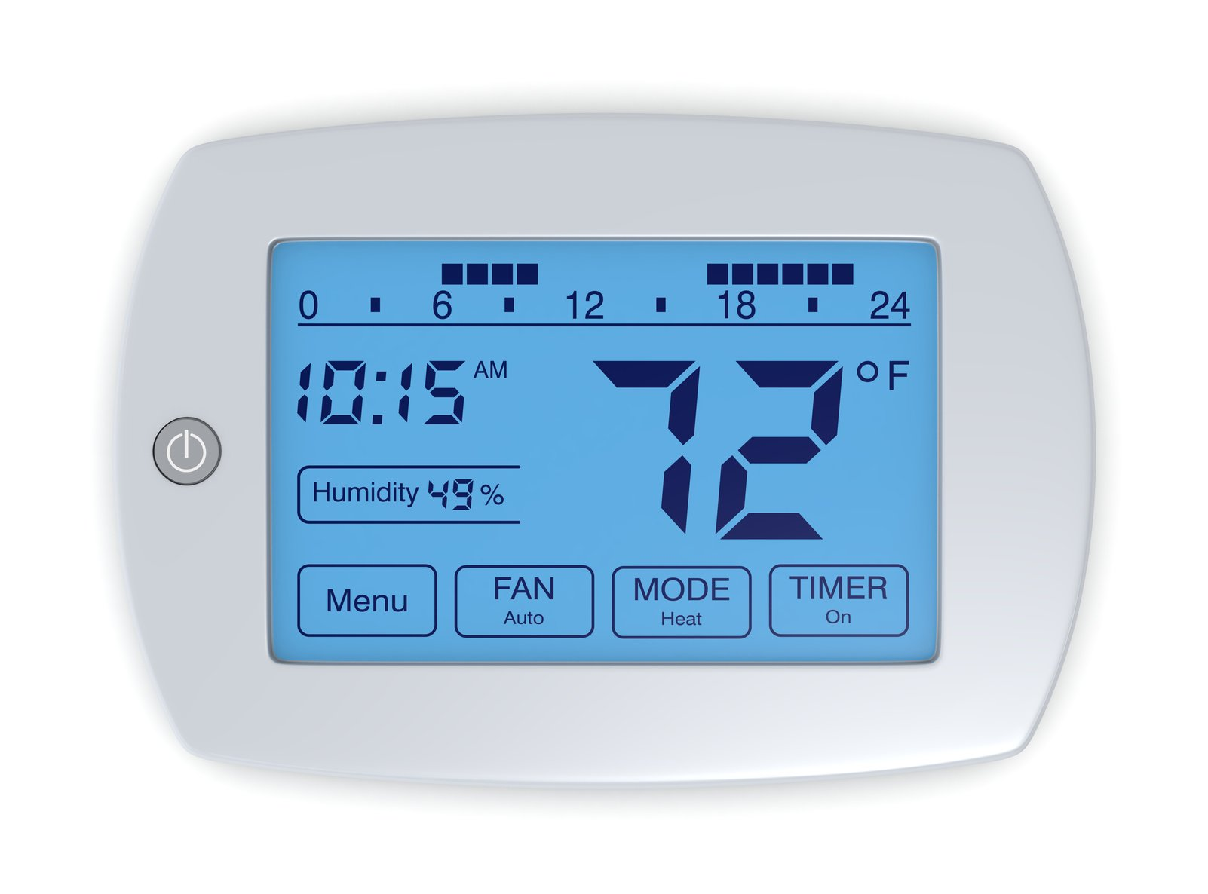
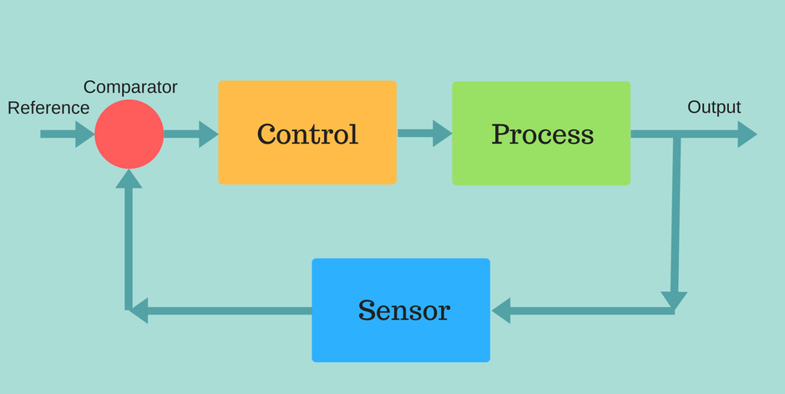
Controllers
Closed Control Loop

Slide 14
Controller
What is it?
Control loops that watch the state of cluster, then make or request changes where needed.
What does it do?
Tracks at least one Kubernetes resource type.
The controller(s) for that resource are responsible for making the current state come closer to that desired state.
How does it do?
The controller might execute action out itself or send messages to the API server (K8S built-in controllers).

Slide 15
Kubernetes Deployment : BTS
Master
Deployment
Controller
Scheduler
Node
2
3
6
7
Create
Deployment
1
API Server
8
Kubelet
4
5
Replica Set
Controller

